Slide 1
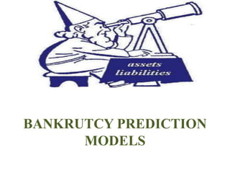
BANKRUPTCY PREDICTION
DESHANT KUMAR JAIN

Slide 2
TABLE OF CONTENT
Problem Statement
Executive Summary
Business Problem
Data Requirements & Data collections
Business Recommendations
Assumptions, Limitations and Further Work

Slide 3
Problem Statement
Prediction of bankruptcy is a phenomenon of increasing interest to firms who stand to loose money because on unpaid debts. Since computers can store huge dataset pertaining to bankruptcy making accurate predictions from them before hand is becoming important.
"In today's volatile financial landscape, accurately predicting bankruptcy is crucial for businesses and investors to mitigate risks and make informed decisions.
This project aims to develop a robust predictive model leveraging machine learning algorithms to forecast the likelihood of a company facing bankruptcy. By analyzing various financial indicators, such as Operating Expense Rate, Research and Development Expense Rate, Interest Bearing Debt Interest Rate, Tax Rate, Revenue per share, Total Asset Growth Rate, Operating Expense Rate, coupled with qualitative factors, we aim to create a reliable tool that can assist stakeholders in identifying early warning signs of financial distress and take proactive measures to prevent bankruptcy."

Slide 4
Data Pipeline
Cleaning the Data: The data was checked for null values, categorical values and primary inspection was performed.
Models: Naïve Bayes, Gradient Boosting, Random Forest
EDA: Exploratory analysis was performed to review the skewness in the data, outliers and correlation patterns.
Model Testing: Combination of different models and feature selection techniques were used to determine optimal results
The datasetconsisted of 96 columns with mainly of continuous featuresin 6819 rows.

Slide 5
DATA SUMMARY
Bankruptcy Data Set
Liability-Assets Flag
Bankrupt
Operating Expense Rate
Tax Rate
Research and Development Expense Rate
Revenue per share
Interest Bearing Debt Interest Rate
Total Asset Growth Rate

Slide 6
DATA SUMMARY
Operating Expense Rate: The operating expense rate shows the efficiency of a company's management by comparing the total operating expense (OPEX) of a company to net sales.
Research and Development Expense Rate: Research and development (R&D) expenses are associated directly with the research and development of a company's goods or services and any intellectual property generated in the process.
Interest Bearing Debt Interest Rate: The interest-bearing debt ratio is significant because it gives a window into the financial health of a company. The interest-bearing debt ratio, or debt to equity ratio, is calculated by dividing the total long-term, interest-bearing debt of the company by the equity value.

Slide 7
DATA SUMMARY
Tax Rate: A tax rate is the percentage at which an individual or corporation is taxed.
Revenue per share: Amount of revenue over common shares outstanding. Answers the question, what's the ownership of sales to each share? Increasing revenue per share (RPS) over time is a good sign, because it means each share now has claim to more revenues.
Total Asset Growth Rate: Total Asset Growth Rate defined as year-over-year percentage change in total assets

Slide 8
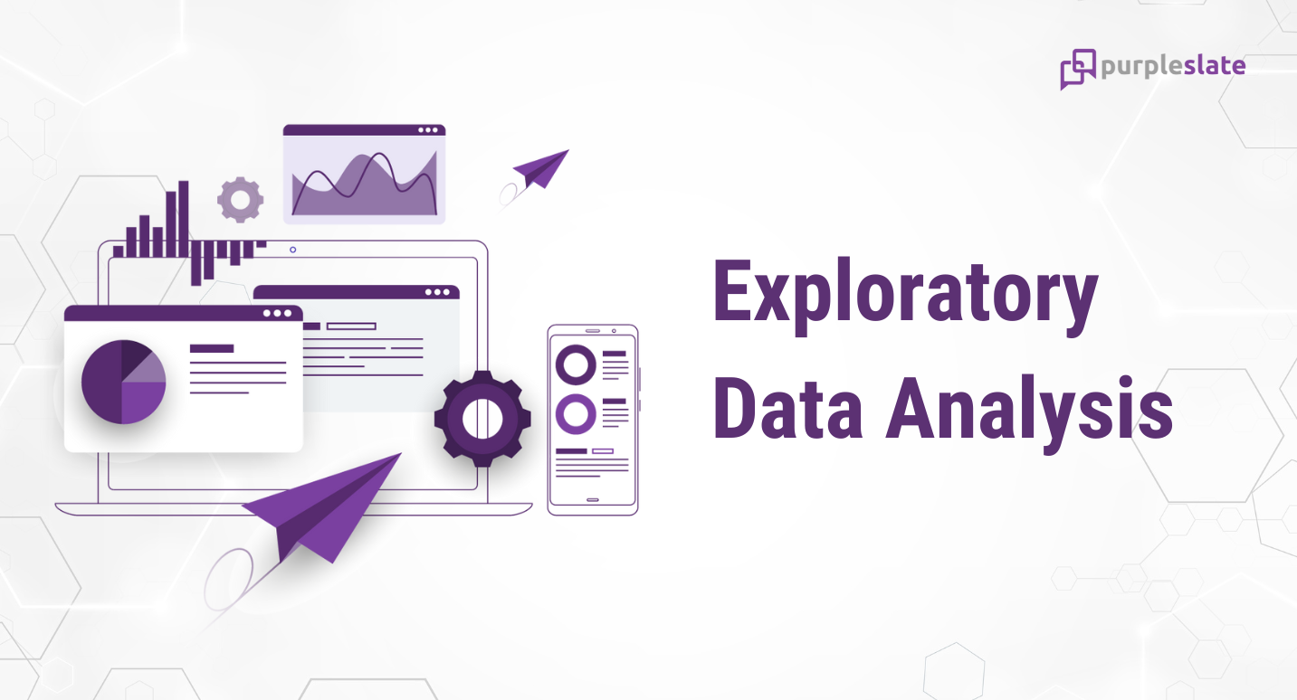

Slide 9
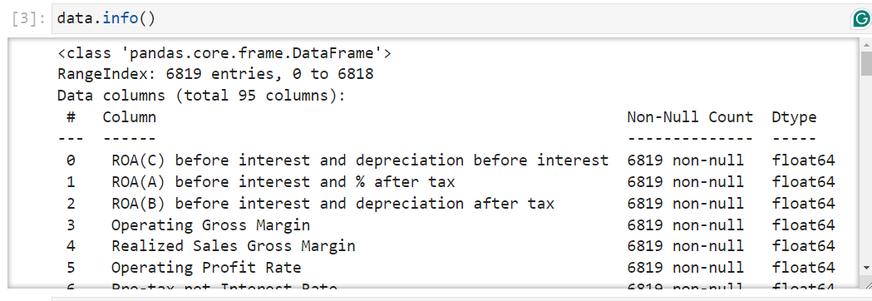
number of row 6819
number of column 95
Data Type - float64(93), int64(2)

Slide 10
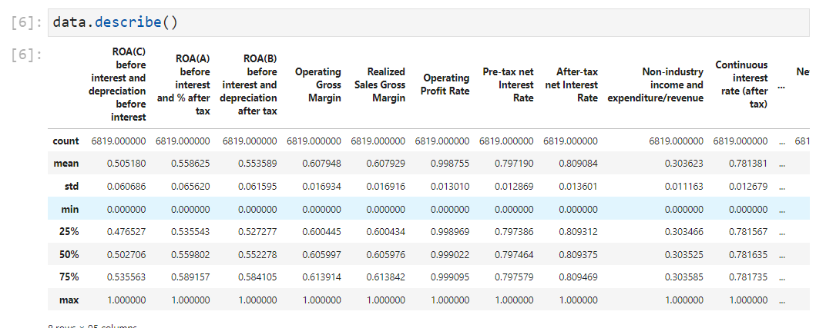
the table provides a summary of financial performance across various profitability metrics.

Slide 11
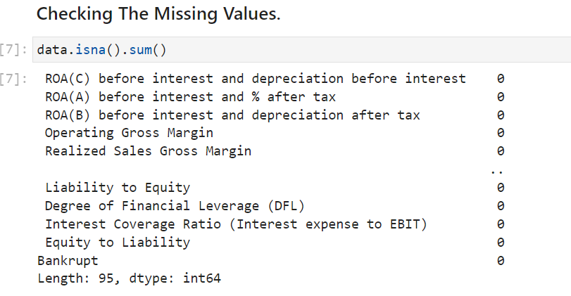
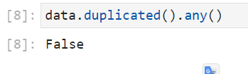
There Are No Missing Values.
There Are No Duplicated Values.

Slide 12
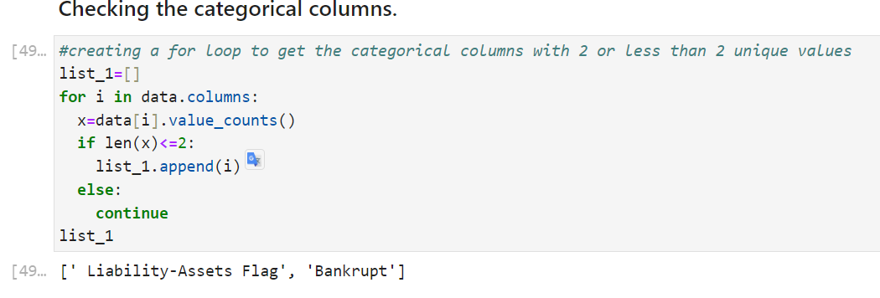
There Are Two Categorical Columns
Liability-Assets Flag
Bankrupt

Slide 13
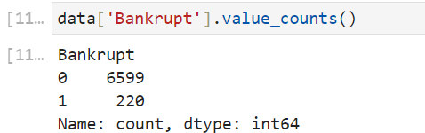
Check For Imbalance Data
0:- non-bankrupt
1:- bankrupt
The output variable is highly imbalanced with minority class accumulating just 3.2% of the data.

Slide 14
Conclusion
The Problem at hand is not an anomaly detection problem. It is a classification problem with a highly imbalanced dataset.
We will use different combinations of feature selection techniques, classification models and resampling techniques to reach a solution

Slide 15
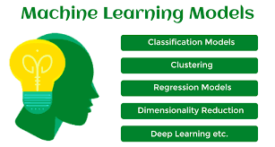
Applying Models
RandomForest
XGBoost
LogisticRegression

Slide 16
RandomForest

Slide 17
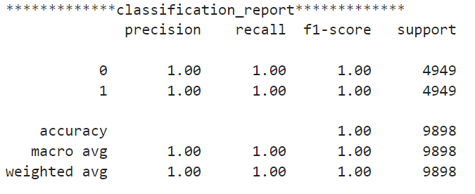
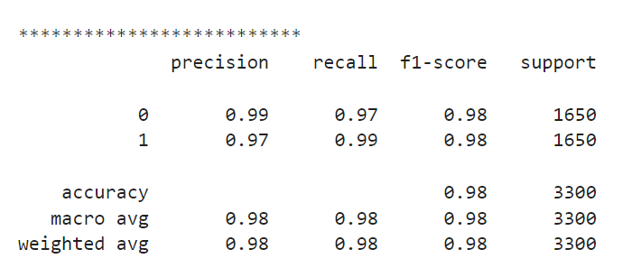
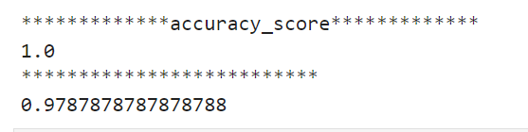
The first model performs exceptionally well with perfect precision, recall, and accuracy, indicating that it perfectly predicts both classes.
The second model also performs well with high precision, recall, and accuracy, though not perfect.
Both models seem to be effective classifiers, but the first model outperforms the second one, likely due to its perfect precision, recall, and accuracy.

Slide 18
XGBoost

Slide 19
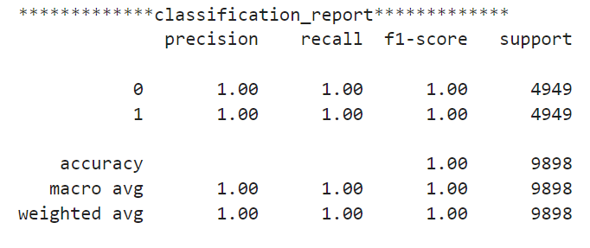
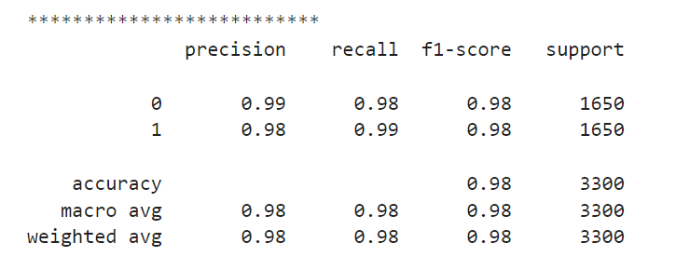
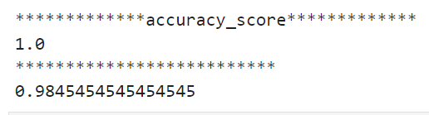
The first model performs exceptionally well with perfect precision, recall, and accuracy, indicating that it perfectly predicts both classes.
The second model also performs well with high precision, recall, and accuracy, though not perfect.
Both models seem to be effective classifiers, but the first model outperforms the second one slightly in terms of accuracy.

Slide 20
Logistic REGRESSION

Slide 21
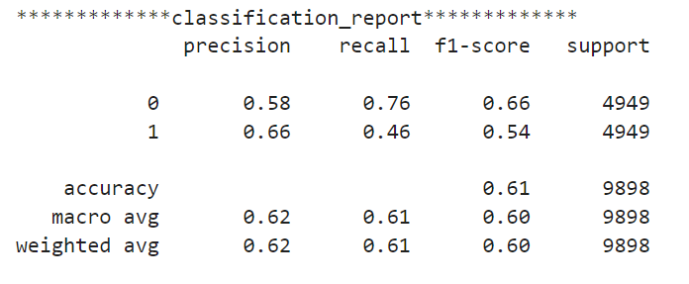
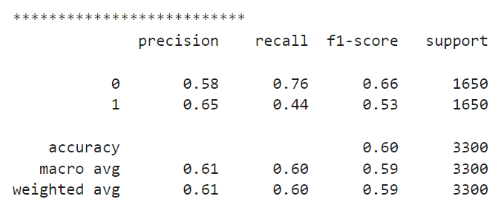
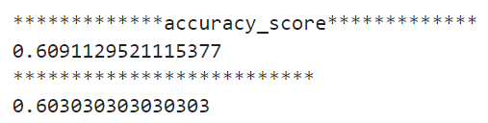
Both models have similar performance, with an accuracy around 60%.
The models perform better in predicting class 0 compared to class 1, as indicated by higher precision, recall, and F1-score for class 0.
However, the overall performance is not very high, indicating that the models might need further optimization or improvement.

Slide 22
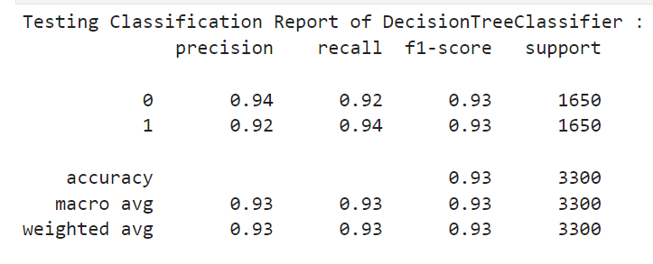
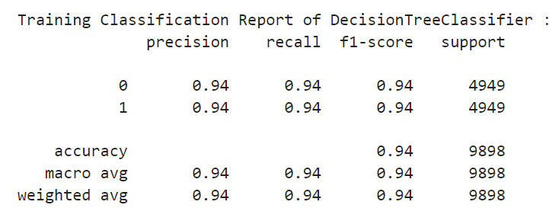
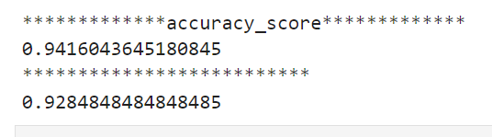
The DecisionTreeClassifier performs consistently well on both the training and testing data.
There is only a slight drop in performance when moving from the training to the testing data, which is expected.
The model shows balanced precision, recall, and F1-score for both classes, indicating that it performs well across different evaluation metrics.
With an accuracy of around 93-94%, the DecisionTreeClassifier seems to be a reliable model for the given classification task.

Slide 23
Conclusion
Both RandomForest Classifier and XGBoost Classifier achieved perfect accuracy (1.0), indicating they classified all instances correctly.
XGBoost Classifier slightly outperforms RandomForest Classifier in terms of weighted F1-score.
Logistic Regression, however, has a significantly lower accuracy compared to the other two models.
Based on the accuracy scores alone, RandomForest Classifier and XGBoost Classifier seem to be the better models for this classification task.

Slide 24
Challenges
Balancing the trade-off between recall and precision was a challenge.
Feature selection and choosing a right technique.
Exploring literature and resources to understand the problem and to
find the solution was a little exhaustive.
Deadlines felt a little strained. But it all worked out for the best

Slide 25
classification_report is | precision | recall | f1-score | support
0 | 0.97 | 1.00 | 0.98 | 1968
1 | 0.64 | 0.21 | 0.31 | 78
accuracy |  |  | 0.97 | 2046
macro avg | 0.80 | 0.60 | 0.65 | 2046
weighted avg | 0.96 | 0.97 | 0.96 | 2046
Yeh model bankrupt hone ki sambhavna mein kuch darshata hai, lekin yeh saath hi sath kuch seemayein aur uncertainty ke saath aata hai.
Precision aur recall metrics se pata chalta hai ki model ke predictions mein kuch galat alarms shamil hote hain aur woh kuch actual bankrupt cases ko miss kar sakta hai.
Isliye, jab bhi koi financial decision lena ho, to model ke vichar ko dhyan mein rakhte hue, aur aur bhi factors ko consider karna zaruri hai.

Slide 26
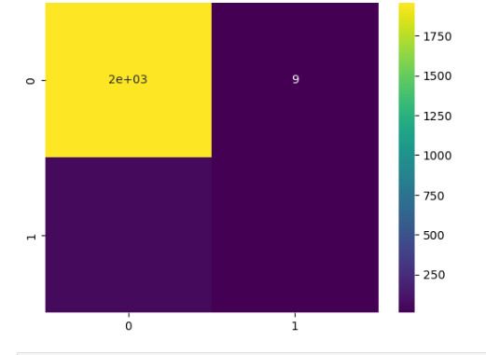
actual classes
TP (True Positive) - सही: 30 companies were correctly predicted to go bankrupt.
FN (False Negative) - गलत: 20 companies that actually went bankrupt were incorrectly predicted as not bankrupt.
FP (False Positive) - गलत: 50 companies were incorrectly predicted to go bankrupt when they actually didn't.
TN (True Negative) - सही: 1500 companies were correctly predicted to not go bankrupt.
TP
FN
class labels
predicted classes
TN
FP

Slide 27
from sklearn.linear_model import LogisticRegression
Yeh line "sklearn" library se "LogisticRegression" class ko import karti hai, jo ki ek prakar ka machine learning model hai jo classification problems ke liye use hota hai.
log_reg = LogisticRegression()
Yahaan, ek naya Logistic Regression model banaya jata hai. "log_reg" naam ke variable mein yeh model store hota hai.

Slide 28
Precision:
Precision batata hai ki model ne kitne sahi predictions kiye hai out of total positive predictions.
"0" class ke liye precision 0.97 hai, matlab ki model ne non-bankrupt ko predict karne mein 97% accuracy dikhayi hai.
"1" class ke liye precision 0.64 hai, matlab ki model ne bankrupt ko predict karne mein 64% accuracy dikhayi hai.
Recall:
Recall batata hai ki kitne sahi predictions kiye gaye hain out of total actual positive cases.
"0" class ke liye recall 1.00 hai, matlab ki model ne sabhi non-bankrupt cases ko detect kiya hai.
"1" class ke liye recall 0.21 hai, matlab ki model ne sirf 21% bankrupt cases ko sahi tareeke se detect kiya hai.
F1-score:
F1-score ek average hai precision aur recall ka, jo harmonic mean ke roop mein calculate kiya jata hai.
"0" class ke liye F1-score 0.98 hai, aur "1" class ke liye F1-score 0.31 hai.
Support:

Slide 29
Support simply yeh batata hai ki har class mein kitne samples hain.
"0" class ke liye 1968 samples hain, aur "1" class ke liye 78 samples hain.
Accuracy:
Accuracy batata hai ki model overall kitni accurate hai.
Yahaan, accuracy 0.97 hai, matlab model overall 97% sahi predictions kar raha hai.
Macro Avg:
Macro avg batata hai ki average precision, recall, aur F1-score kya hai har class ke liye.
Precision, recall, aur F1-score ka macro avg dekha jaaye toh, woh 0.80, 0.60, aur 0.65 hai.
Weighted Avg:
Weighted avg bhi average precision, recall, aur F1-score ka hai, lekin yeh class ke samples ke hisaab se weighted hai.
Yahaan, weighted avg precision, recall, aur F1-score 0.96, 0.97, aur 0.96 hai.

